Slide 2
Motivation

Slide 3
Challenges
Easy to define a number of mathematical concepts; but hard to define a number of language concepts, e.g. unigram, POS, etc.
RNN/LSTM models dynamic temporal behavior for a time sequence, but hard to model extremely long learning history of over months even years.

Slide 4
Dataset
TO ADD: average sequence length

Slide 5
Word-level context encoder and char-level encoder
0
1
0
0
0
0
0
1
0
0
0
0
0
1
0
0
1
0
0
0
0
0
1
0
0
0
0
1
0
0
0
0
1
0
0
0
0
1
0
0
0
0
0
1
0
0
0
0
1
0
0
0
0
1
0
A cute cat
A c u t e c a t

Slide 6
BiLSTM layer
BiLSTM layer
Mean-over-time
BiLSTM layer
0
1
0
0
0
0
0
1
0
0
0
0
0
1
0
One-hot lookup
0
1
0
0
0
0
0
1
0
0
0
0
1
0
0
0
0
1
0
0
0
0
1
0
0
0
0
0
1
0
0
0
0
1
0
0
0
0
1
0
One-hot lookup
A cute cat
Word-level Context Encoder
A c u t e c a t
Character-level Context Encoder

Slide 7
BiLSTM layer
Concatenation
0
1
0
0
0
0
1
0
0
0
0
0
1
0
0
0
0
1
0
0
0
0
0
1
0
0
0
0
1
0
One-hot lookup
DT det JJ amod NN root
POS Tag and Syntactic Edge Label Encoder
Notes:
http://nlp.stanford.edu:8080/parser/index.jsp

Slide 8
Concatenation +
Concatenation +
Fully connected
Fully connected
0.28 (normalized)
0.28 (normalized)
One-hot lookup /
Normalization
One-hot lookup /
Normalization
0
1
0
0
0
0
1
0
0
0
0
1
0
0
0
0
1
0
0
0
0
1
0
0
0
IUG23+FSJJ Columbia 5.74 days
Format Session Client Time (25.8 sec)
User Encoder
Format Encoder
Notes:
http://nlp.stanford.edu:8080/parser/index.jsp

Slide 9
Concatenation +
Concatenation +
Fully connected
Fully connected
0.28 (normalized)
0.28 (normalized)
One-hot lookup /
Normalization
One-hot lookup /
Normalization
0
1
0
0
0
0
1
0
0
0
0
1
0
0
0
0
1
0
0
0
0
1
0
0
0
IUG23+FSJJ Columbia 5.74 days
Format Session Client Time (25.8 sec)
User Encoder
Format Encoder
Notes:
http://nlp.stanford.edu:8080/parser/index.jsp

Slide 10
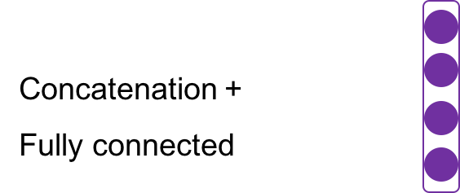
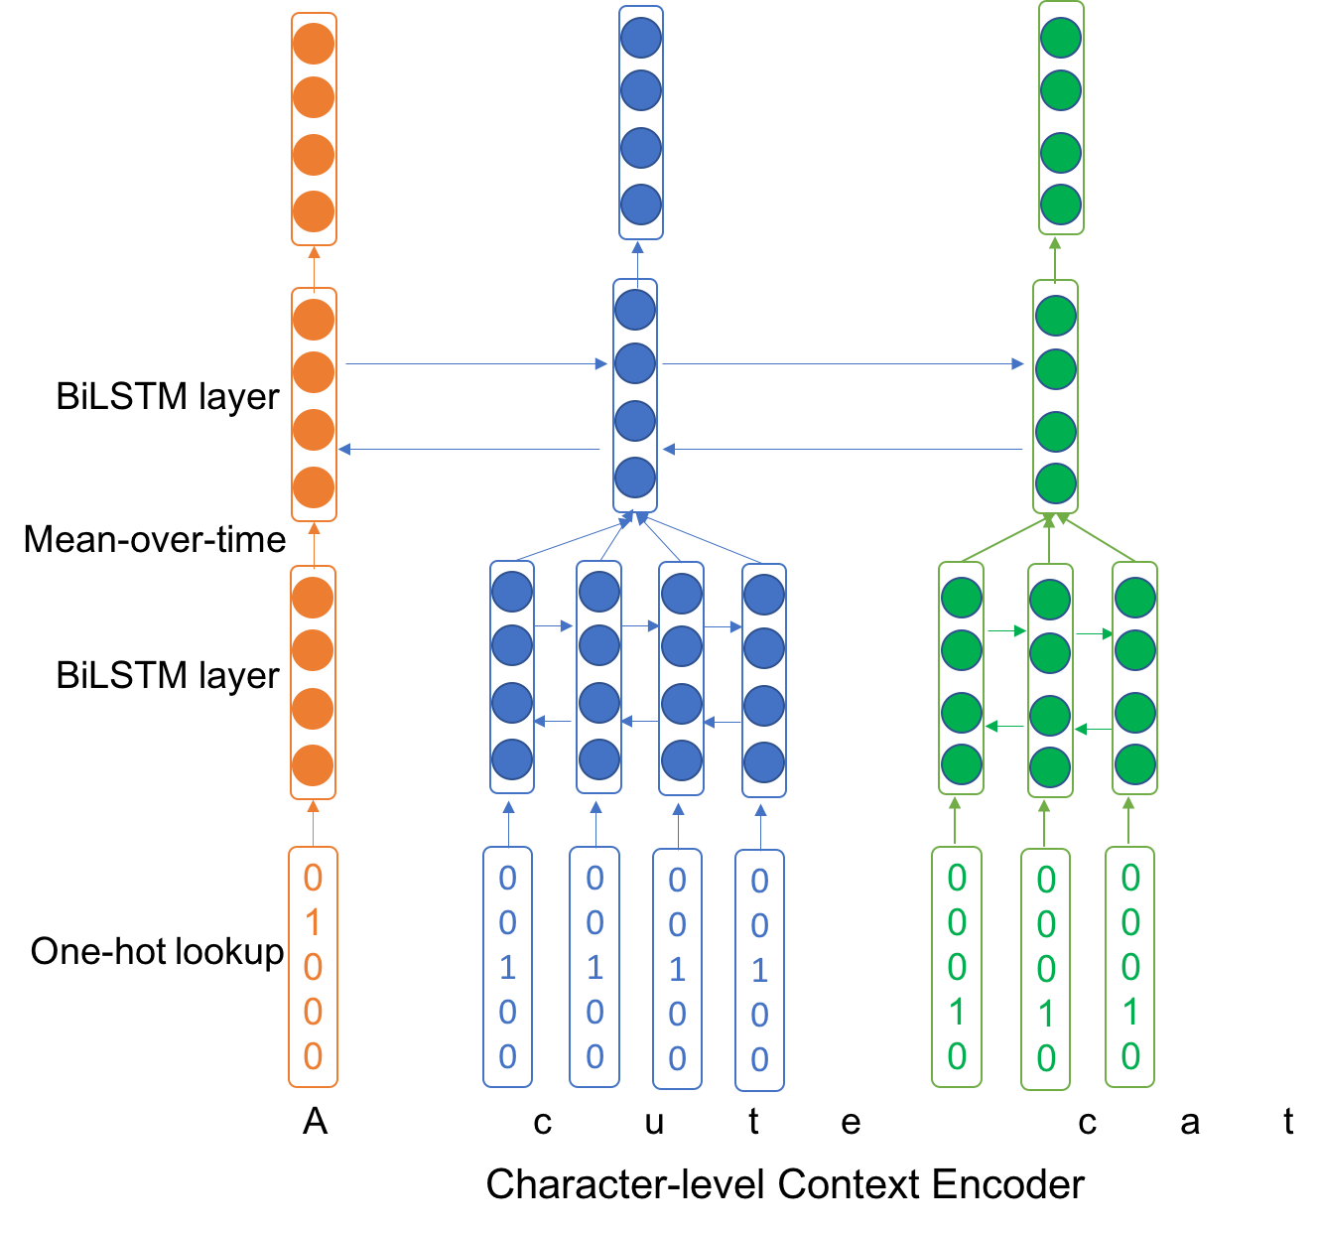
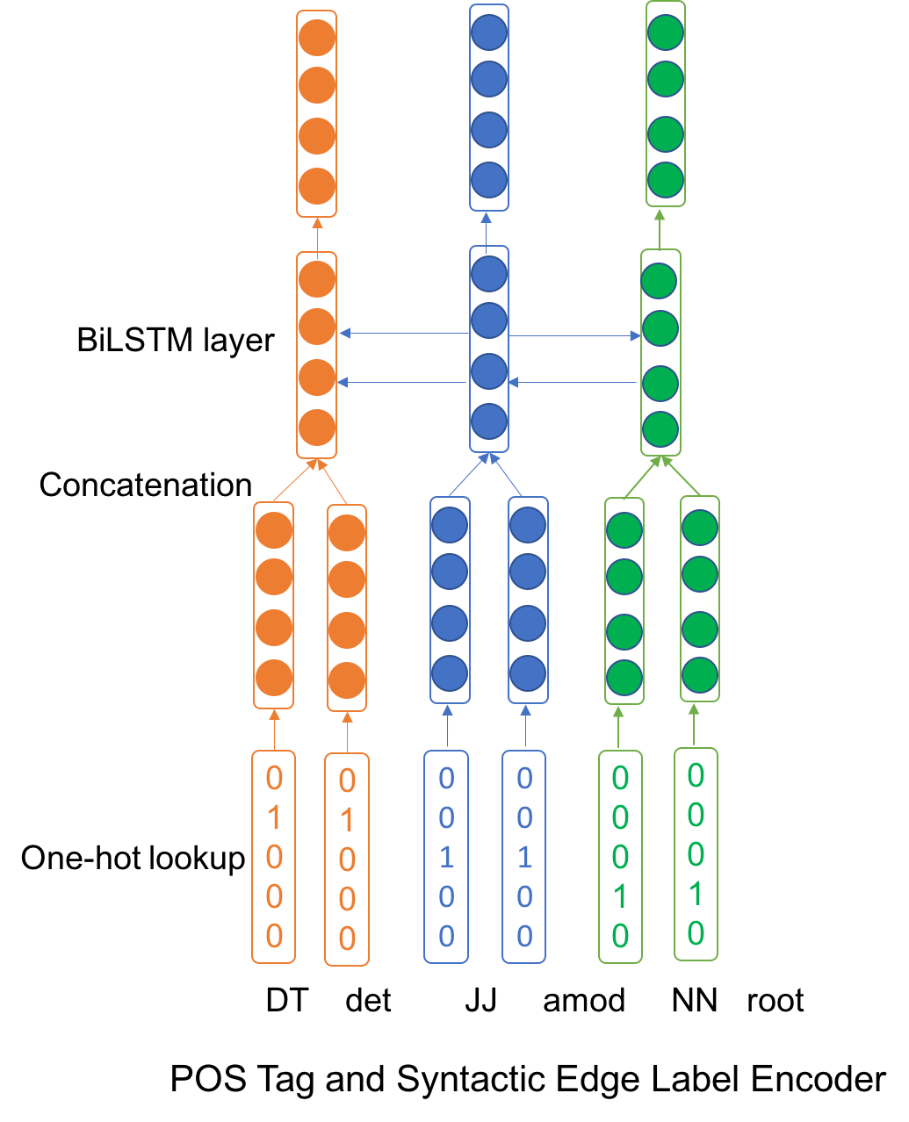
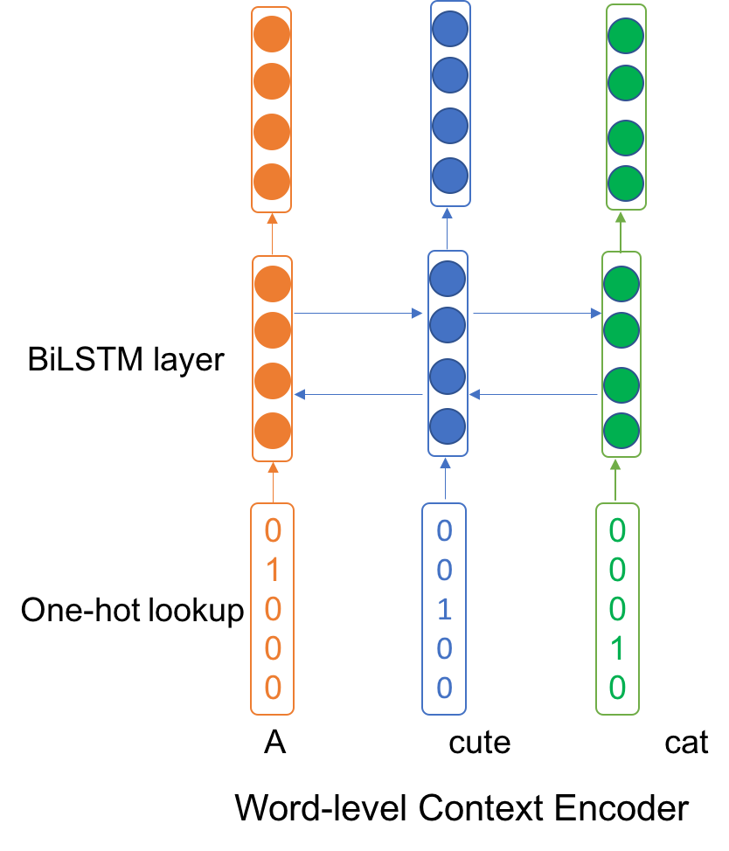
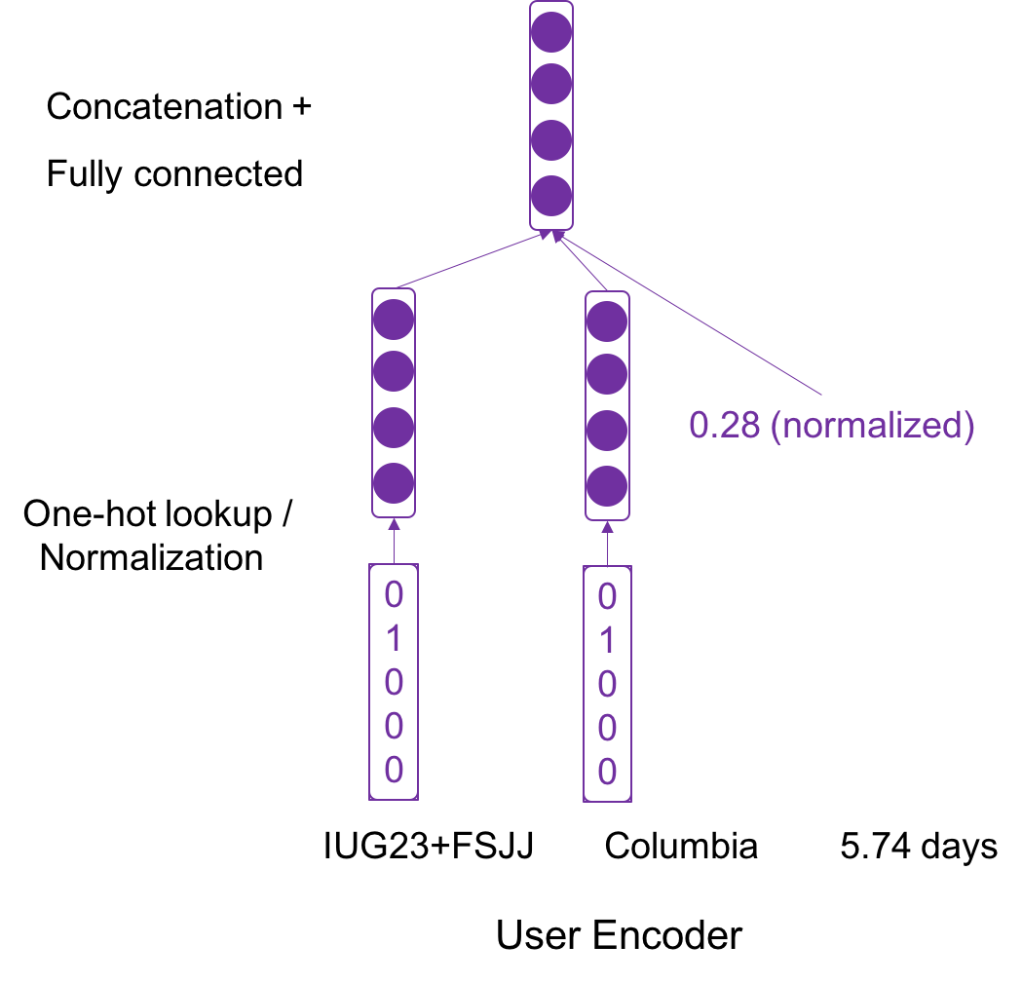
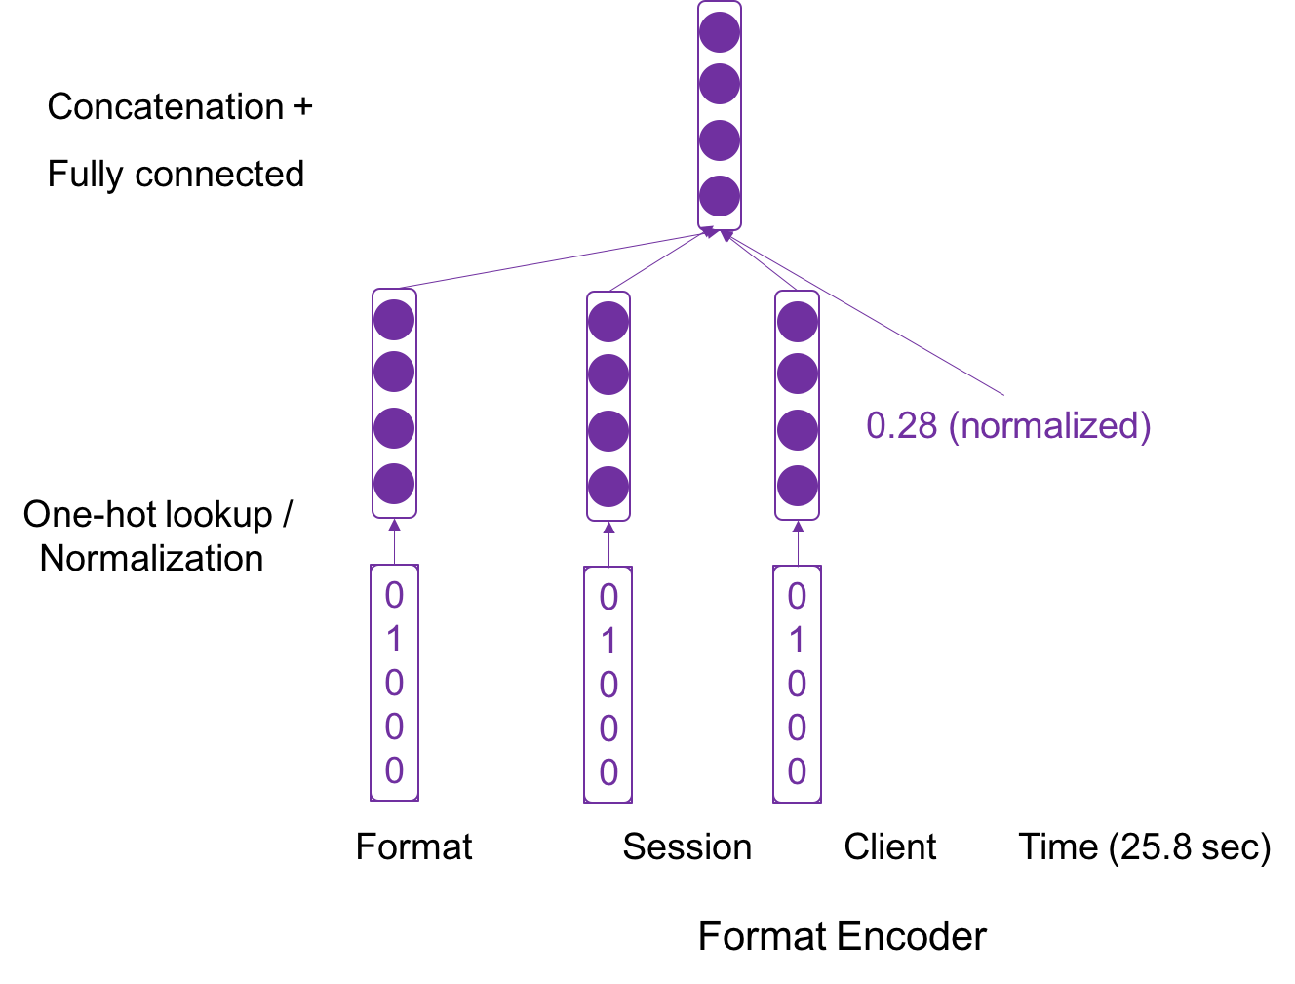
Decoder
√ × ×
1st Context Encoder
2nd Linguistic Feature Encoder
3rd User Encoder
4th Format Encoder

Slide 11
Playground
0
1
0
0
0
0
0
0
0
0
1
0
0
0
0
0
0
0
10
0
0
0
0
0
0
0
1
0
A c u t e cat

